Slide 1
Dapper Vs Entity Framework
Entity Framework Core (EF Core) and Dapper are both Object-Relational Mapping (ORM) tools used in .NET applications to interact with databases. However, they differ significantly in their approach, performance, flexibility, and use cases.

Slide 2
Key Differences Between EF Core and Dapper
Feature | EF Core | Dapper
Type | Full-featured ORM | Micro ORM
Performance | Slower than Dapper (due to abstraction) | Very fast (near raw SQL performance)
Complexity | High-level abstraction | Low-level, close to SQL
Ease of Use | Easier for basic CRUD; automatic tracking | Requires more manual coding
Query Style | LINQ (Language Integrated Query) | Raw SQL queries
Change Tracking | Yes, built-in | No change tracking
Caching | Yes, built-in (first-level) | No caching

Slide 3
Key Differences Between EF Core and Dapper
Feature | EF Core | Dapper
Migrations | Built-in support for code-based migrations | No migration support
Use Case | Ideal for applications needing rapid development and model abstraction | Ideal for high-performance data access or when using complex SQL
Learning Curve | Easier for beginners | Requires better understanding of SQL
Relationships | Handles complex relationships, navigation properties | Manual joins, no automatic relationship handling
Unit of Work / Repositories | Integrated | Manual implementation if needed

Slide 4
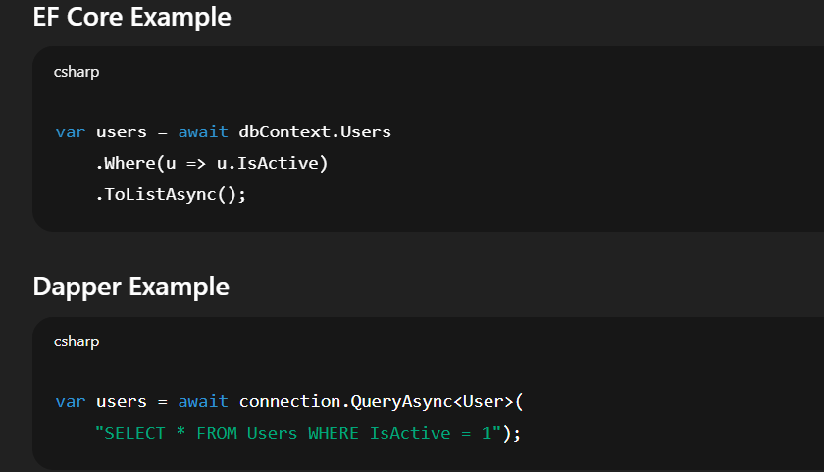
Example Usage

Slide 5
When to Use What?
Use EF Core if:
You want rapid development with less boilerplate code.
You need change tracking, migrations, and rich LINQ support.
Your application is data-driven and not performance-critical.
Use Dapper if:
You want maximum performance (e.g., large-scale read-heavy systems).
You are writing custom SQL queries or using stored procedures.
You prefer control over queries and don’t need change tracking.

